Slide 1
CPS 315 OOP Collaborative Programming Project 13.8
By: Doua Yang, Chris Carmody and Sam Harris
Date: 08/08/2018

Slide 2
Project one: Programming Exercise 13.8
Design and implement a program that prompts the user to enter a string and then performs two palindrome tests. The first should use a single stack to test whether the string is a palindrome. The second should use two stacks to test whether the string is a palindrome when capitalization, spaces, punctuation, and other non-alphanumeric characters are ignored. The program should print the results of both tests.

Slide 3
Collaborative Tools
Slack collaborative work space
GitHub code sharing platform

Slide 4
Slack
Slack is a collaborative platform that allows for team members to communicate with and update the entire team on the status of work and projects seamlessly.
Slack pushes notifications to team members when updates are entered and allows for tracking of updates on GitHub.

Slide 5
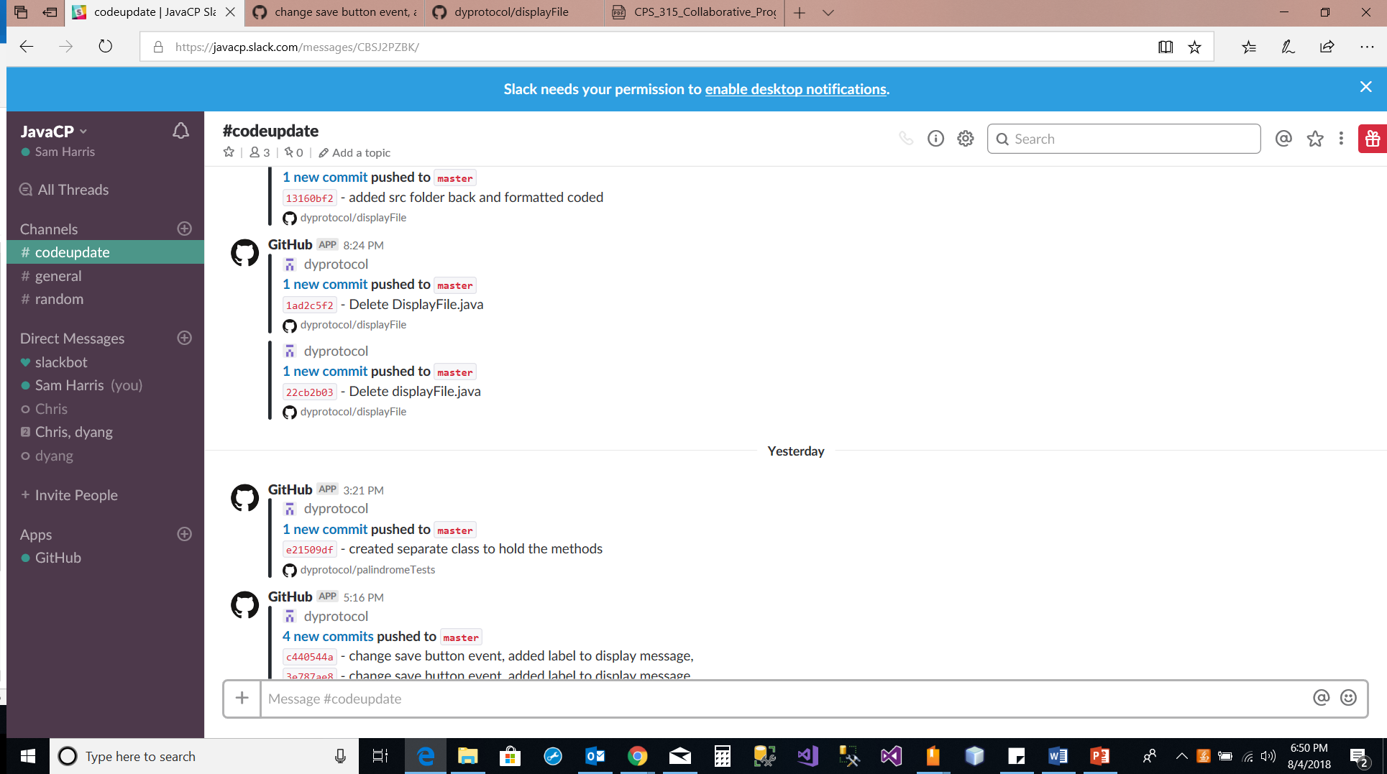
Slack in use showing notifications of code updates

Slide 6
GitHub
GitHub is a web-based hosting service bosting open source versioning control of software projects.

Slide 7
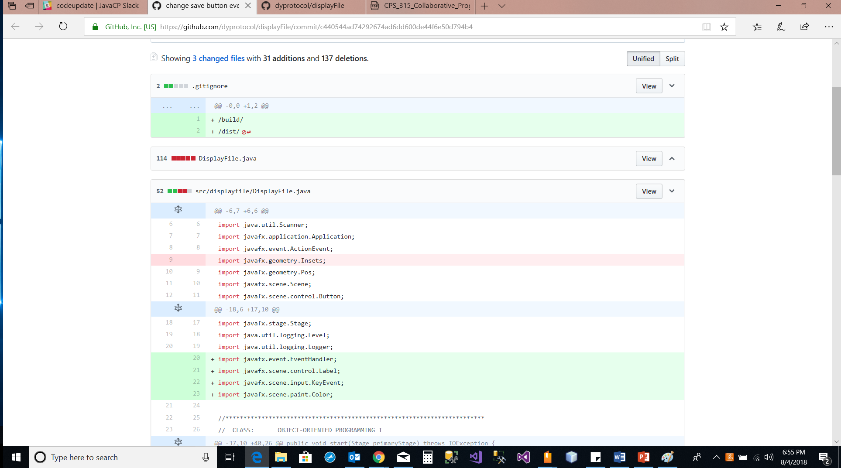
Github in use showing revisioning tools in place.

Slide 8
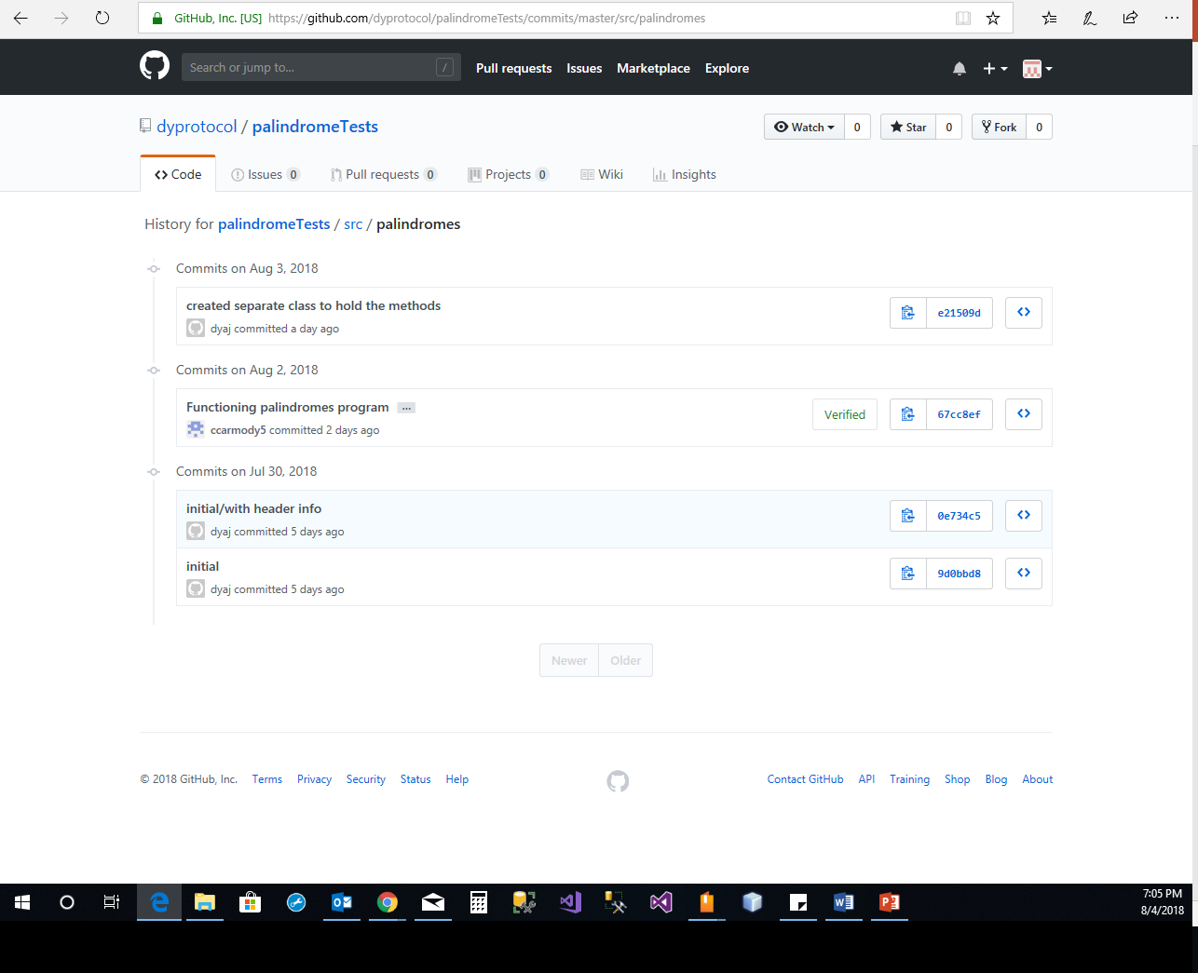
Github in use showing Testing and time stamp tools.

Slide 9
Group activities
Doua took the lead and setup both the slack account and GitHub account for the group to get started with communication and code sharing.
Chris took the lead on the program design for project 13.8 and was able to quickly get working code out to the group for testing and verification.

Slide 10
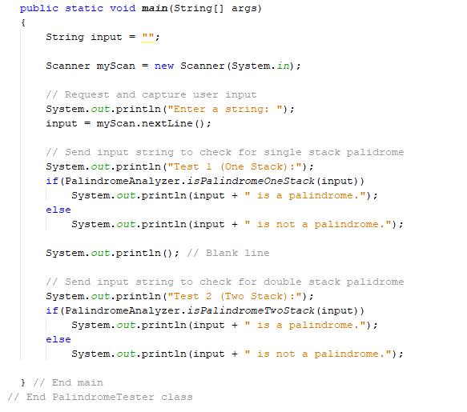
Code

Slide 11
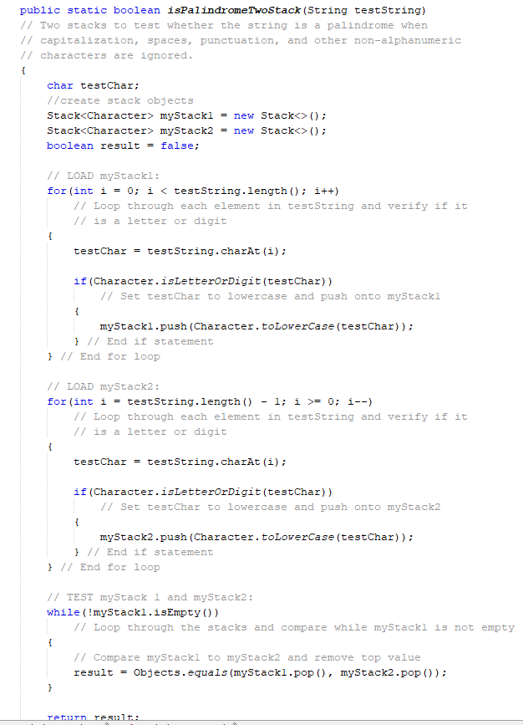
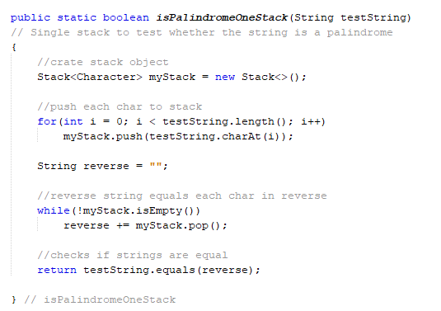
Code

Slide 12
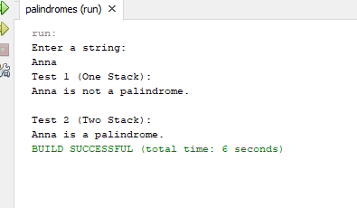
Application

Slide 13
Summary
Pros
The programming project was not very involved so it worked out well that one person took the lead on getting a rough draft of the program completed for group review.
After group review a few changes were made and the final draft was submitted for final review by the group and approved for release. It allowed for different perspectives on the organization of the code.
Slack work well for notifying the group of changes and updates and GitHub work well for document sharing and revision control.
Utilizing team resources like GitHub and slack provided great exposure to the tools.
Cons
Working within a group for small project was more involved and took more time than completing the code independently.
Waiting on group reviews and updates slowed the process a little

